Slide 1

Fostering Cultural Sustainability: Scaling Businesses, Preserving Traditions
Preserving cultural practices while scaling businesses is key. We aim to connect artisans to global markets. Our sustainable platform champions indigenous knowledge. Join us in fostering cultural sustainability.

Slide 2
The Cultural Sustainability Challenge
Loss of Heritage
Exclusion of Knowledge
Globalization and economic pressures threaten cultural heritage.
Indigenous knowledge is often excluded from
business.
Limited Market Access
Need for Models
Traditional craftspeople lack access to wider markets.
Sustainable economic models are needed to protect cultural assets.

Slide 3
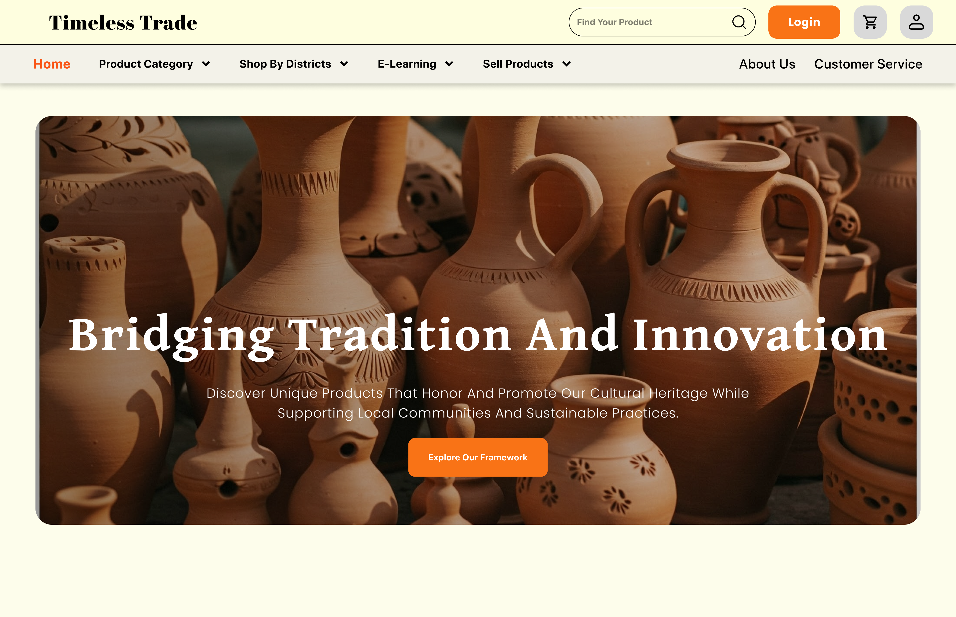



Our Solution: Timeless
Trade
Ethical Focus
Sustainable Model
Global Reach
Our website connects artisans with global markets. It promotes ethical and sustainable practices. Key features include e-commerce, storytelling, and resources.

Slide 4
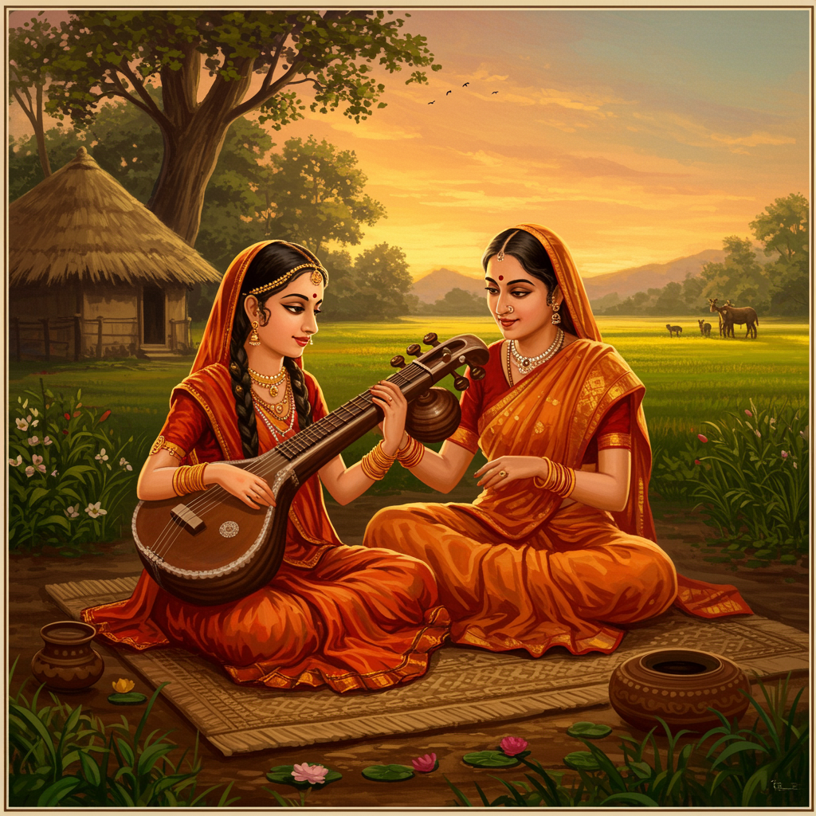



Empowering Artisans Through E-commerce
Tailored Platform
Global Support
E-commerce platform designed for handcrafted goods.
Multilingual support and shipping integration.
Fair Pricing
Direct payment options for artisans ensure fair pricing.

Slide 5
E-Learning Hub USP
Artisan Profiles
Highlight instrument history, techniques, and stories with better connection.
Visual Storytelling
Use product photography and videography method to show case their tradition .
Cultural Significance
Showcase significance of products. For eg –baul,sitar,harmonium.

Slide 6




Sustainable Business Model
Premium Services
Grants and Donations
Marketing support
From organizations
Commission-Based Revenue
2
3
10-15% per sale
Impact Investing
Sustainable growth
1
4

Slide 7




Impact & Scalability
Increased Artisan Income
Cultural Preservation
Global Reach
Success measured by income, preservation, and reach. Scalability through tech and partnerships. Long-term vision: a global ecosystem.

Slide 8
Call to Action: Join Timeless Trade
Support Artisans
Partner With Us
Explore unique cultural products.
Amplify our impact.
Visit Our Website

Slide 9
Team Members
1) DIWAKAR PRADHAN
2) ARGHADEEP PAKHIRA
3) SHUBHAM BHUNIA
4) ANKITA CHANDA
5) ANIRBAN PATRA

Slide 10

Thank You
Thank you for your time. Join us in fostering cultural sustainability.
Contact us with any questions.

